Slide 1
Flow Control Instructions
Course Code: COE 3205
Course Title: Computer Organization & Architecture
Dept. of Computer Science
Faculty of Science and Technology
Lab No: | 7 | Week No: | 8 | Semester: | Spring 21-22
Lecturer: | Md. Siyamul Islam Siyamul@aiub.edu

Slide 2
Lab Outline
Decision making and repeating statement
Level

Slide 3
Jump
Jump instructions transfers control to another program
The transfers can be unconditional or condition
Depends on a particular combination of status flags settings

Slide 4
Unconditional Jump
Does not depend on any condition
Syntax
Jump destination_level
Example : jmp level1

Slide 5
Conditional Jump Conti…
Depends on a particular combination of status flags settings
Syntax
Jump destination_level
Example : jnz level1

Slide 6
Conditional Jump
There are three types of conditional jumps
Signed Conditional Jumps
Unsigned Conditional Jumps
Single-Flag Jumps

Slide 7
Signed Conditional Jump
JG or JNLE | Jump if Greater than Jump if Not Less than or Equal to | ZF = 0 and SF = OF
JGE or JNL | Jump if Greater than or Equal to Jump if Not less than or Equal to | SF = OF
JL or JNGE | Jump if less than Jump if not greater than or equal | SF<>OF
JLE or JNG | Jump if less than or Equal Jump if not greater than | ZF = 1 or SF<> OF
Notes:
dl=5, dh=2
cmp dl,dh ; here cmp subtracts dh from dl = 5-2 = 3, ZF=0, SF=0, OF=0, SF=OF
Jg Level1
----------------------------
dl=2, dh=5
cmp dl,dh ; here cmp subtracts dh from dl = 2-5 = -3, ZF=0, SF=1, OF=0, SF<>OF
JL level1

Slide 8
Unsigned Conditional Jump
JA or JNBE | Jump if Above Jump if Not Below or Equal to | ZF = 0 and CF = 0
JAE or JNB | Jump if Above or Equal to Jump if Not Below | CF = 0
JB or JNAE | Jump if Below Jump if not Above or Equal | CF = 1
JBE or JNA | Jump if Below or Equal Jump if Not Above | CF=1 or ZF = 1

Slide 9
Single-Flag Conditional Jump
JE or JZ | Jump if Equal Jump if equal to Zero | ZF = 1
JNE or JNZ | Jump if Not Equal Jump if Not Zero | ZF = 0
JC | Jump if Carry | CF = 1
JNC | Jump if no Carry | CF=0
JO | Jump if Overflow | CF=1 or ZF = 1
JNO | Jump if No Overflow | OF=1
JS | Jump if Sign Negative | SF = 1
JNS | Jump if Non-Negative Sign | SF =0
JP/JPE | Jump if Parity Even | PF=1
JNP/JPO | Jump if parity Odd | PF=0

Slide 10
Label
Jump instruction has a general format jxx label where label is a facility offered by the assembler
Labels are used with jump and loop statements to refer another instruction
Labels are needed to refer another instruction

Slide 11
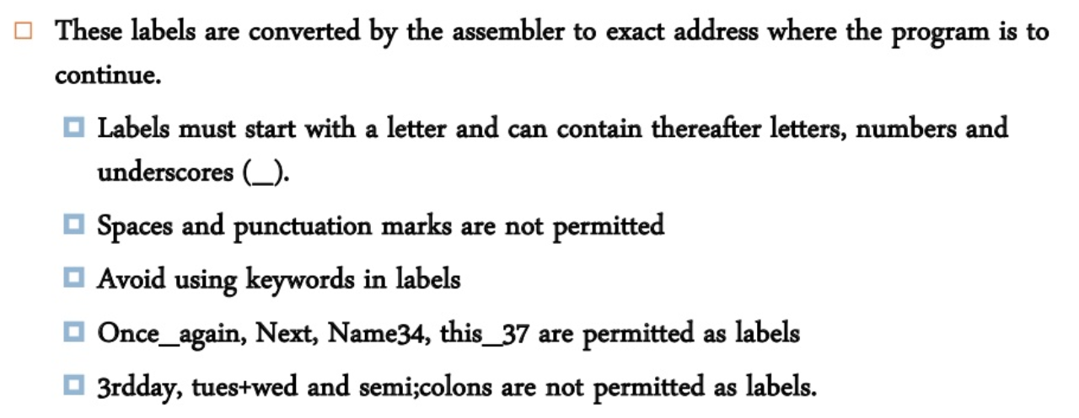
Label

Slide 12
Label
Example
Jmp Exit
Exit:
Mov ah, 4ch
Int 21h

Slide 13
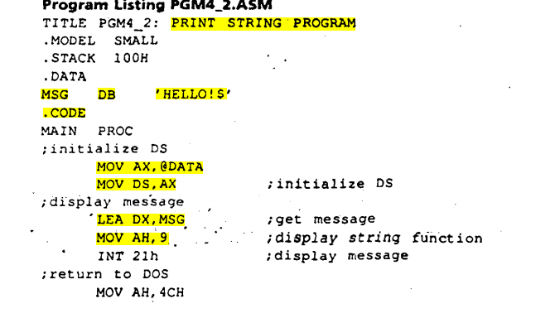

Slide 14
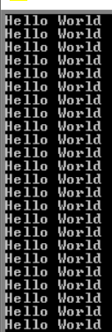
Lab Tasks
Task: 1
Write an assembly program that non-stop prints Hello World. Hints: Use unconditional jmp and level instructions.
Sample Output
Hello world
Hello world
Hello world
Hello world
Hello world
Hello world
Hello world
……………
……………..
Hello world

Slide 15
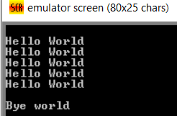
Lab Tasks
Task: 2
Write an assembly program that prints Hello World five times and then prints Bye world. Hints: Use unconditional CMP, conditional JE, JNE instruction.
Sample Output
Hello world
Hello world
Hello world
Hello world
Hello world
Bye world

Slide 16
Lab Tasks
Task: 3
Read an integer from user. Check whether the number is positive or negative. Hints: JMP, JL, JG instructions
Sample output
Enter a number: 1
Positive
Enter a number: -1
Negative

Slide 17



Lab Tasks
Task: 4
Suppose that CL contains the value of 5. Take an integer from user. Compare the value with CL. And show whether the user input is less than, greater than and equal to CL. Hints: use CMP, JL, JG, JE
Sample output
Enter a number: 1
Less than 5
Enter a number: 7
Greater than 5
Enter a number: 5
Equal to 5

Slide 18
Lab Tasks
Task: 5
Read a character and display it 50 times on the next line. Hints: use DEC and JNZ instructions and
Sample Output
Enter a character: d
dddddddddddddddddddddddddddddddddddddddddddddddddd
Thank you.

Slide 19
Lab Tasks
Task: 6
Write a program to check password using Assembly Programming. Suppose the password is mypassword
Sample output
Enter your password: mypassword
Password Matched
Enter your password: password
Password Not Matched

Slide 20
Books
Assembly Language Programing and Organization of the IBM PC
Ytha Yu
Charles Marut

Slide 21
References

